Slide 1
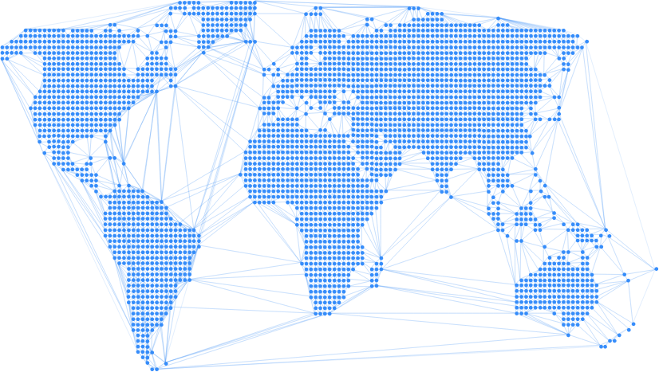

Enable
Creating opportunity through peer-to-peer stablecoin loans

Slide 2
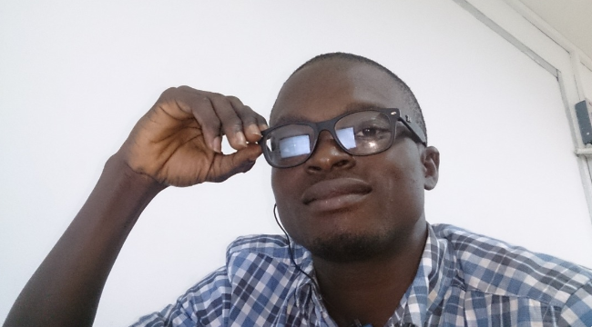
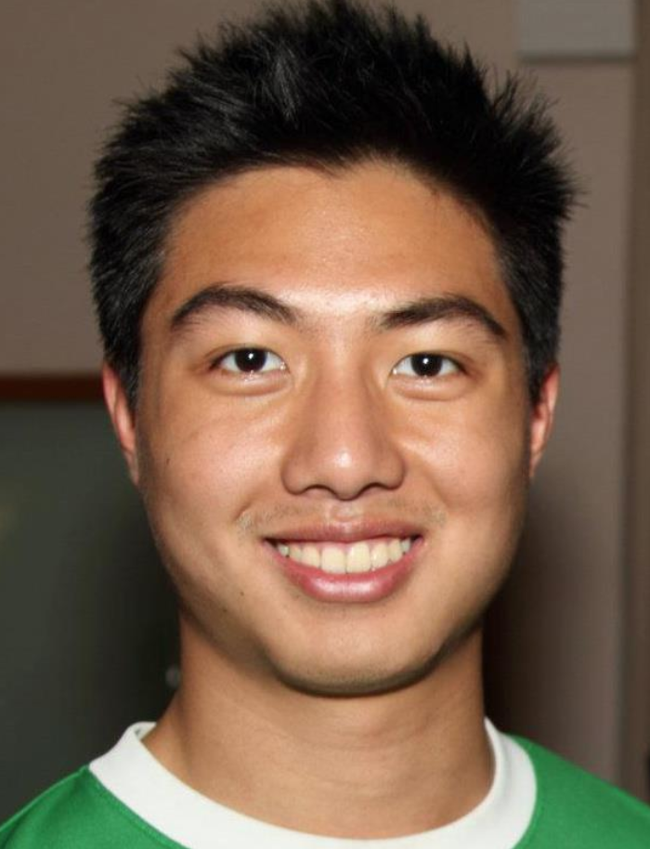
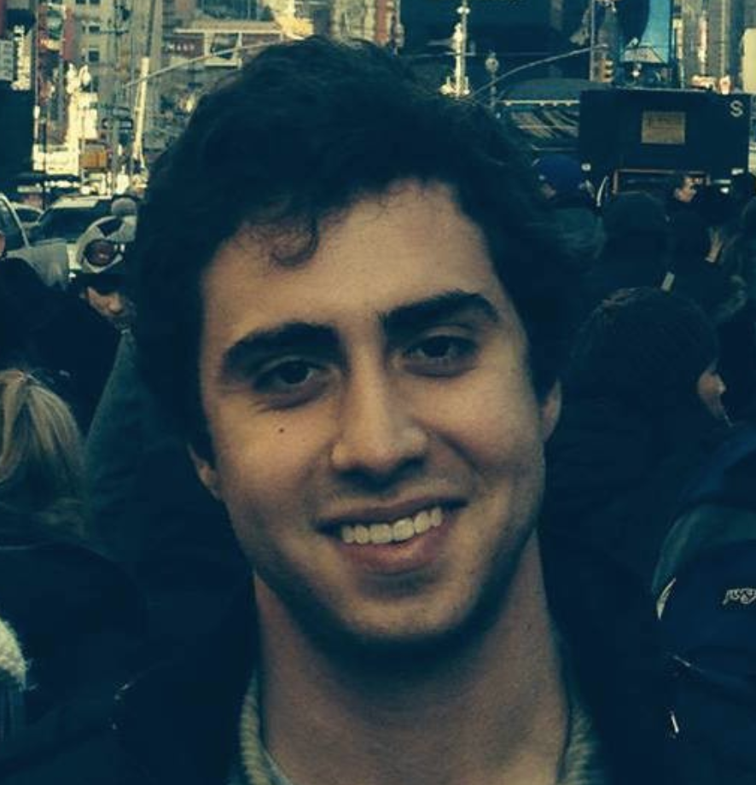
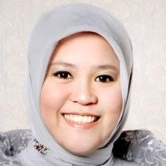

Anthony
Daniel
Thomas
Ines
Faisal

Slide 3
3 Things we’ve learnt since the Hackathon

Slide 4
1. Will people lend?
https://github.com/enabledao/enable/issues/74

Slide 5
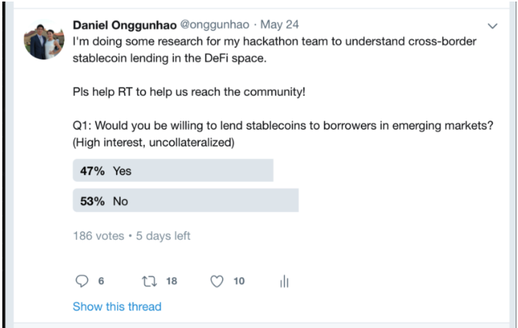

Slide 6
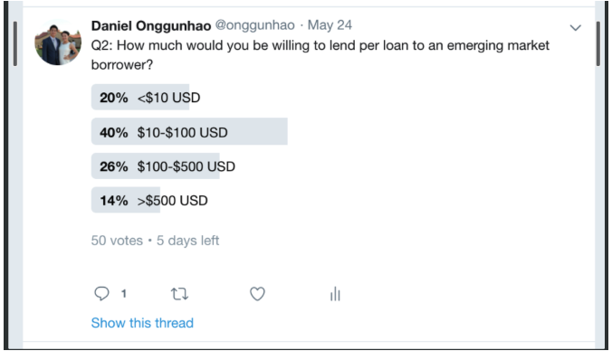
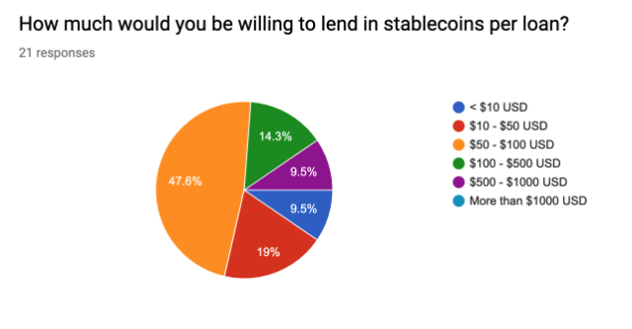

Slide 7
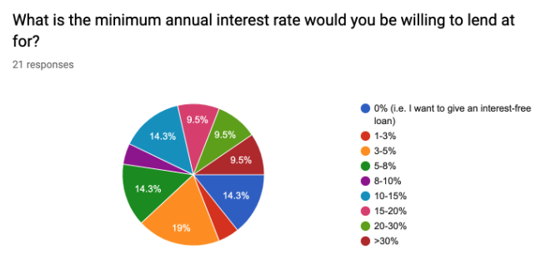

Slide 8
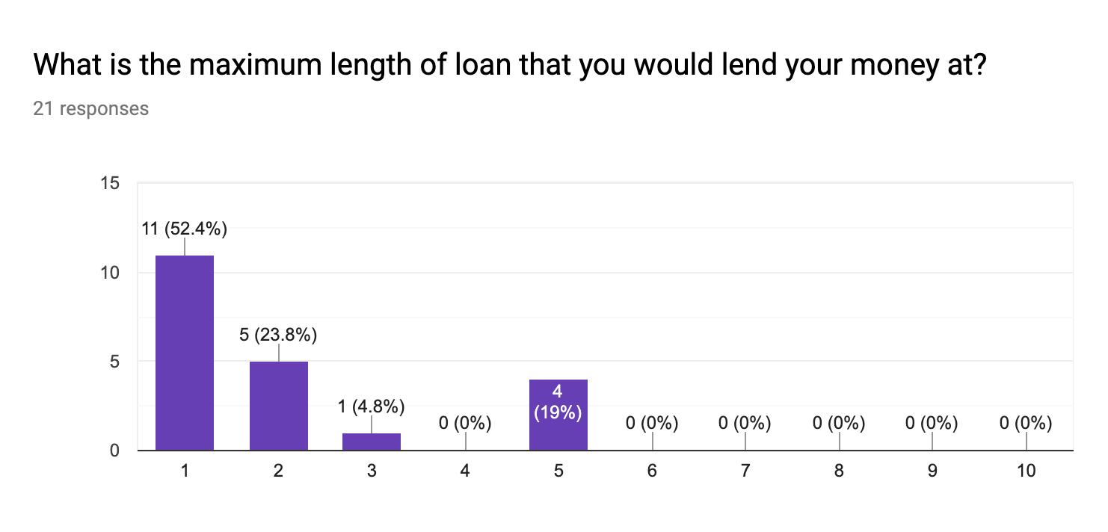

Slide 9
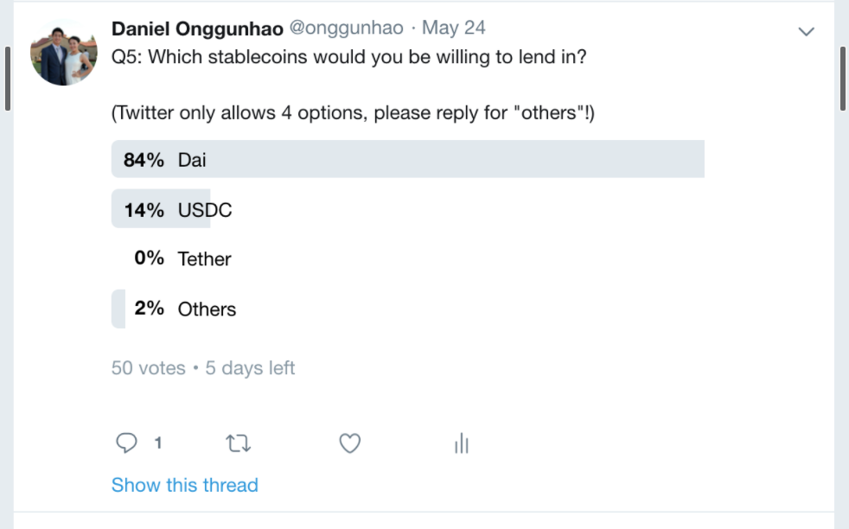
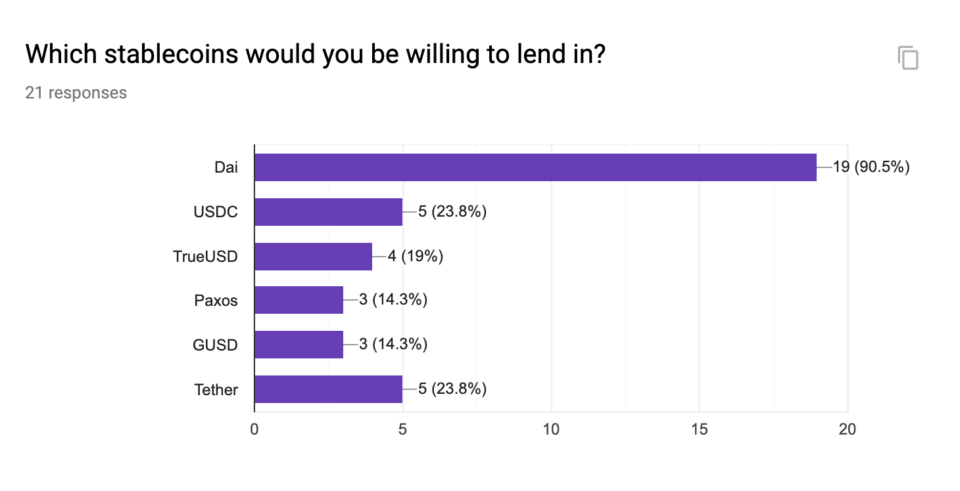

Slide 10
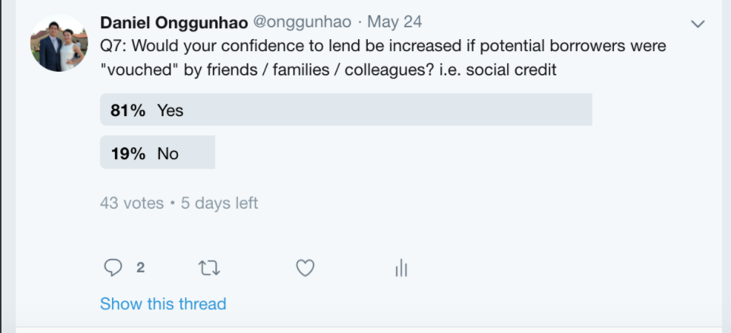
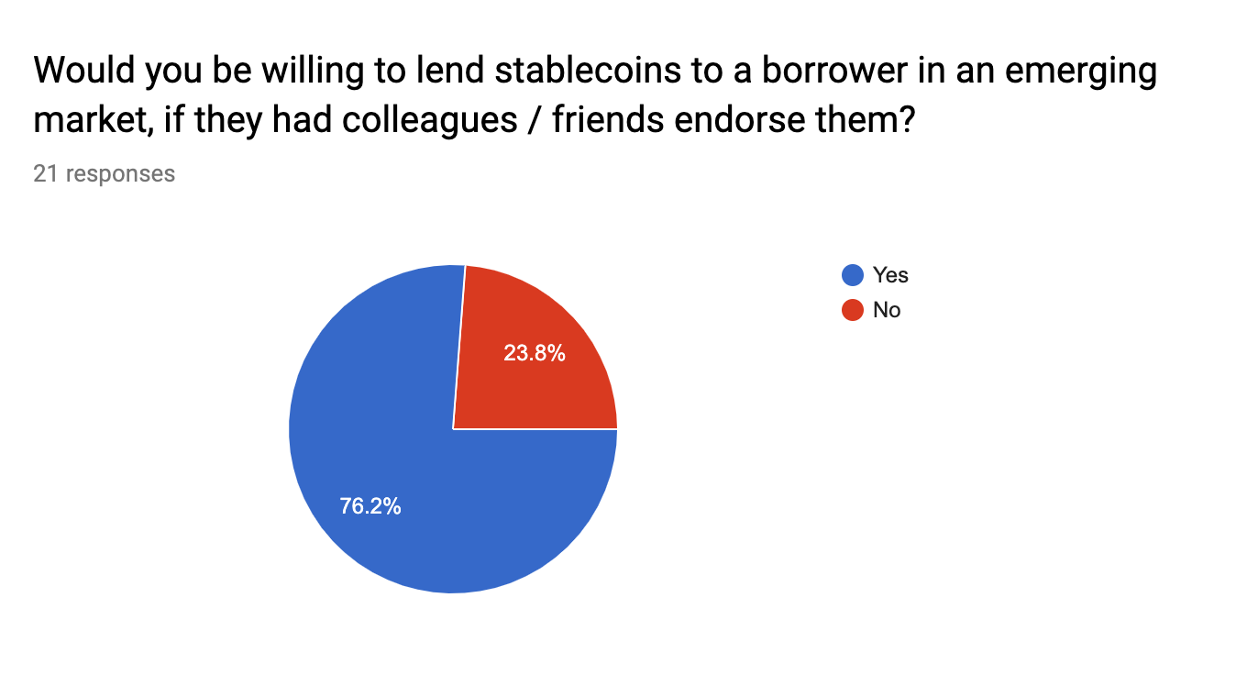

Slide 11
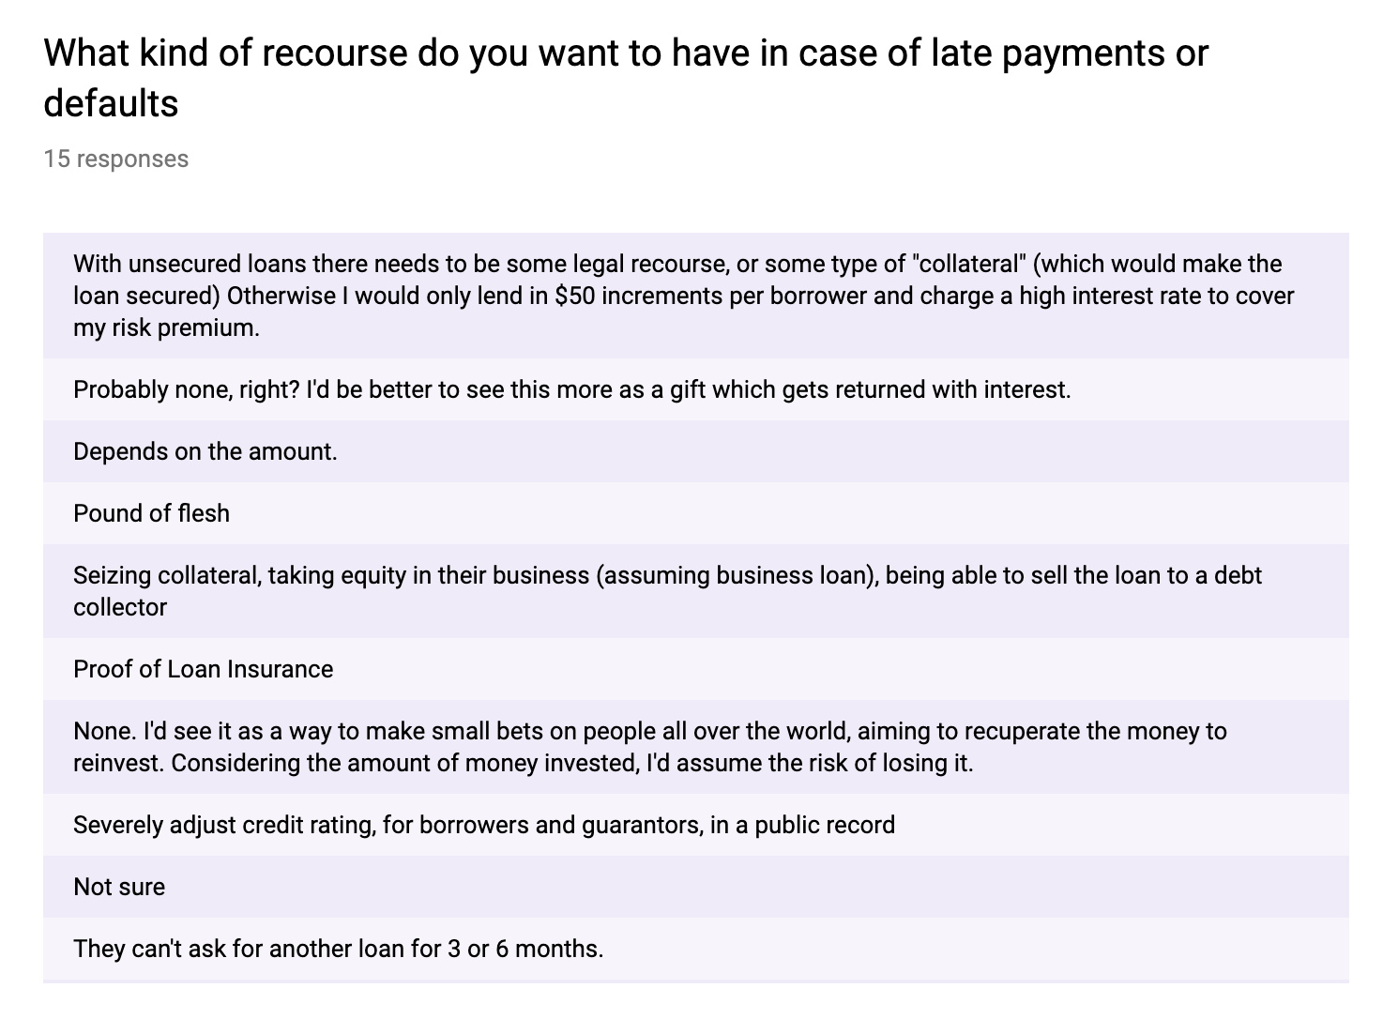

Slide 12
2. Is there a sustainable business model?
https://github.com/enabledao/enable/issues/90

Slide 13
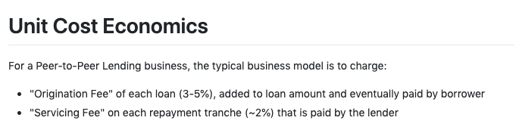
https://github.com/enabledao/enable/issues/90

Slide 14
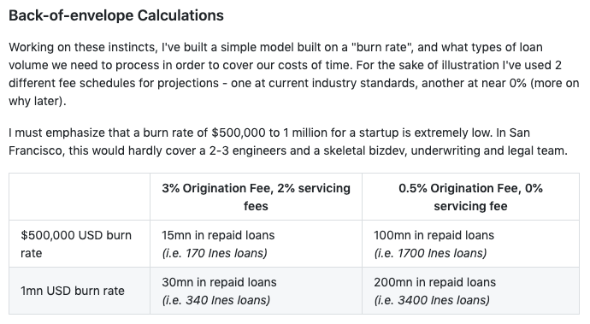
https://github.com/enabledao/enable/issues/90

Slide 15
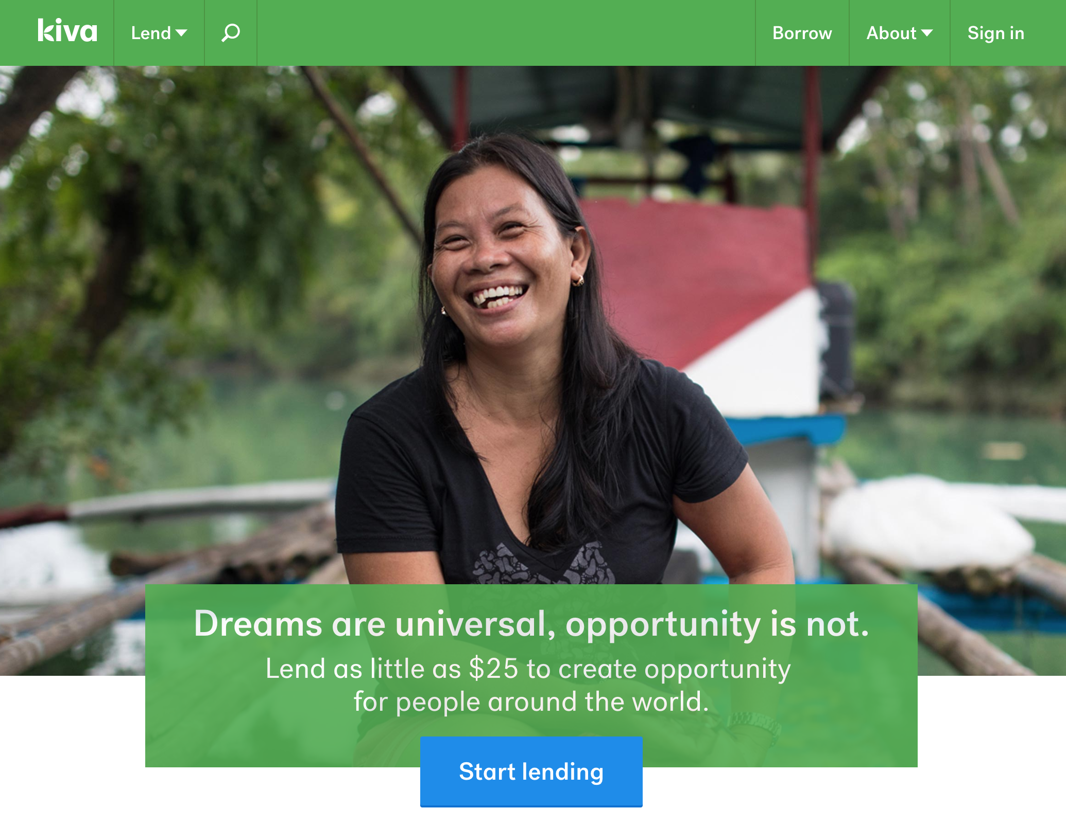
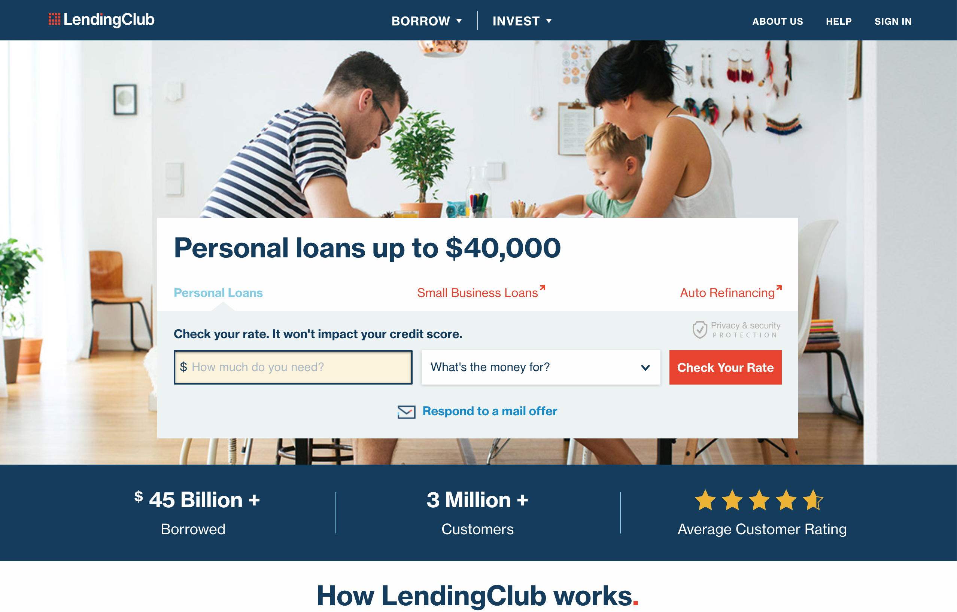
or

Slide 16
3. Our new direction: ”Riskiest Assumption Test”
https://github.com/enabledao/enable/issues/90

Slide 17
Open Source Dai Stablecoin Loan Kit
Open Source Dai Loan contract
Open Source dApp

Slide 18
15th July: Ines’ fundraise
60,000 Dai for 12 months, 6% interest rate

Slide 19
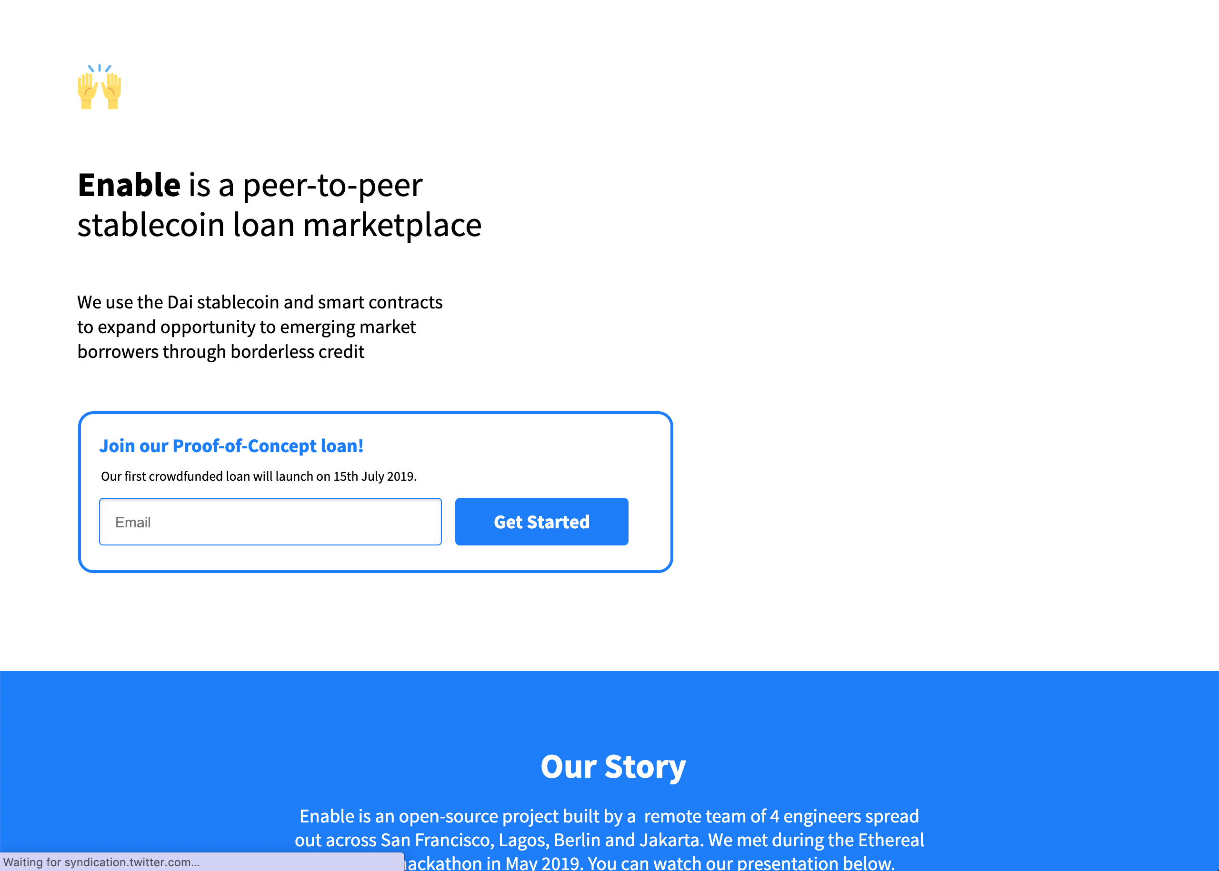
New site!
www.enable.credit

Slide 20
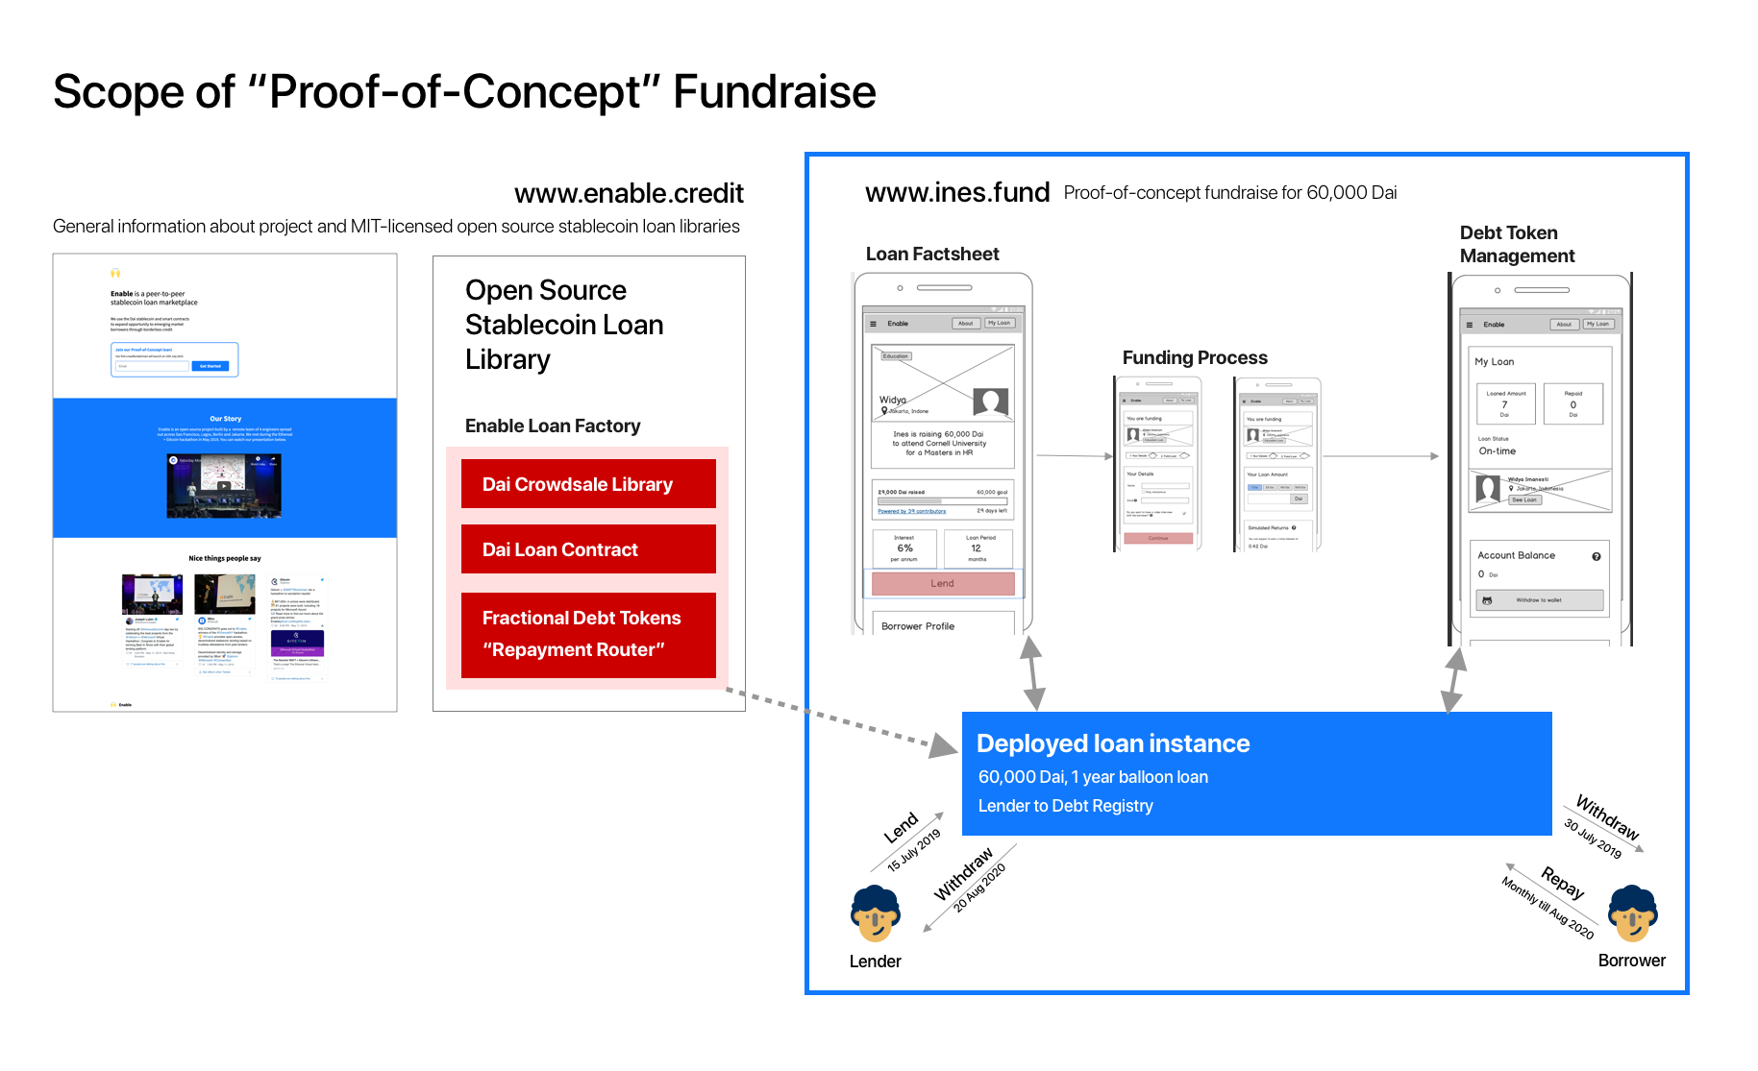

Slide 22
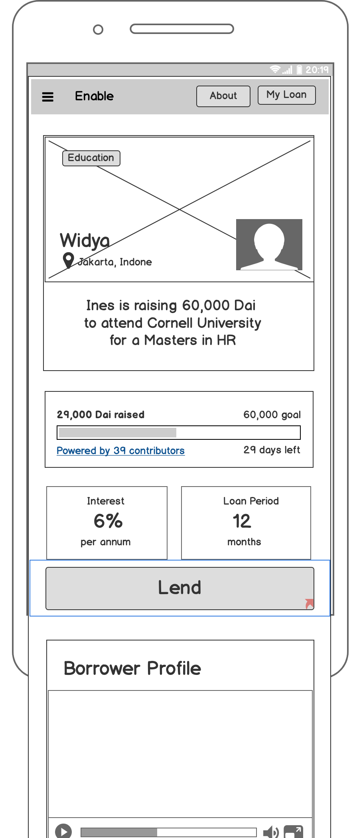
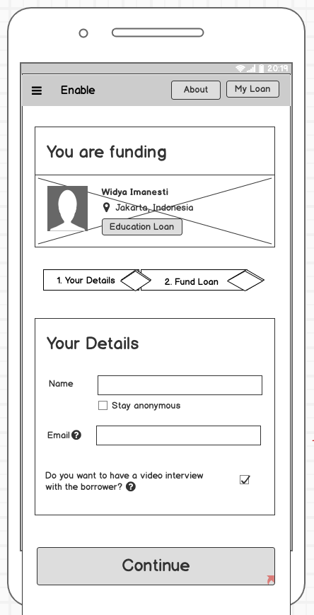
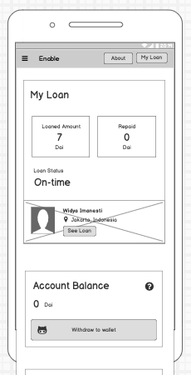
Validating ideas in Comic Sans

